Slide 1

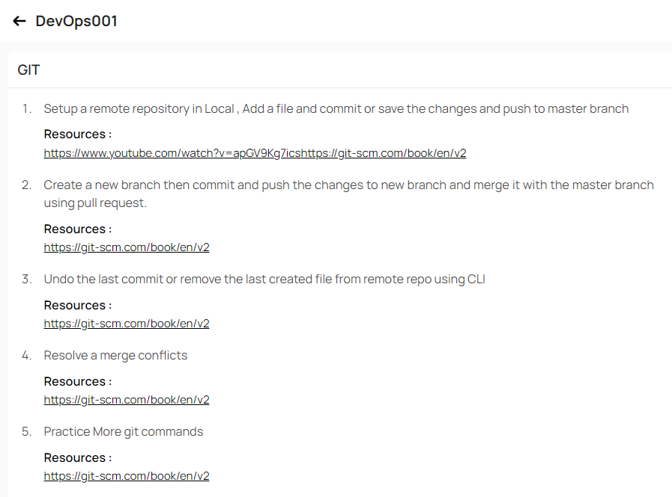
Himanshu Kumar Singh

Slide 2
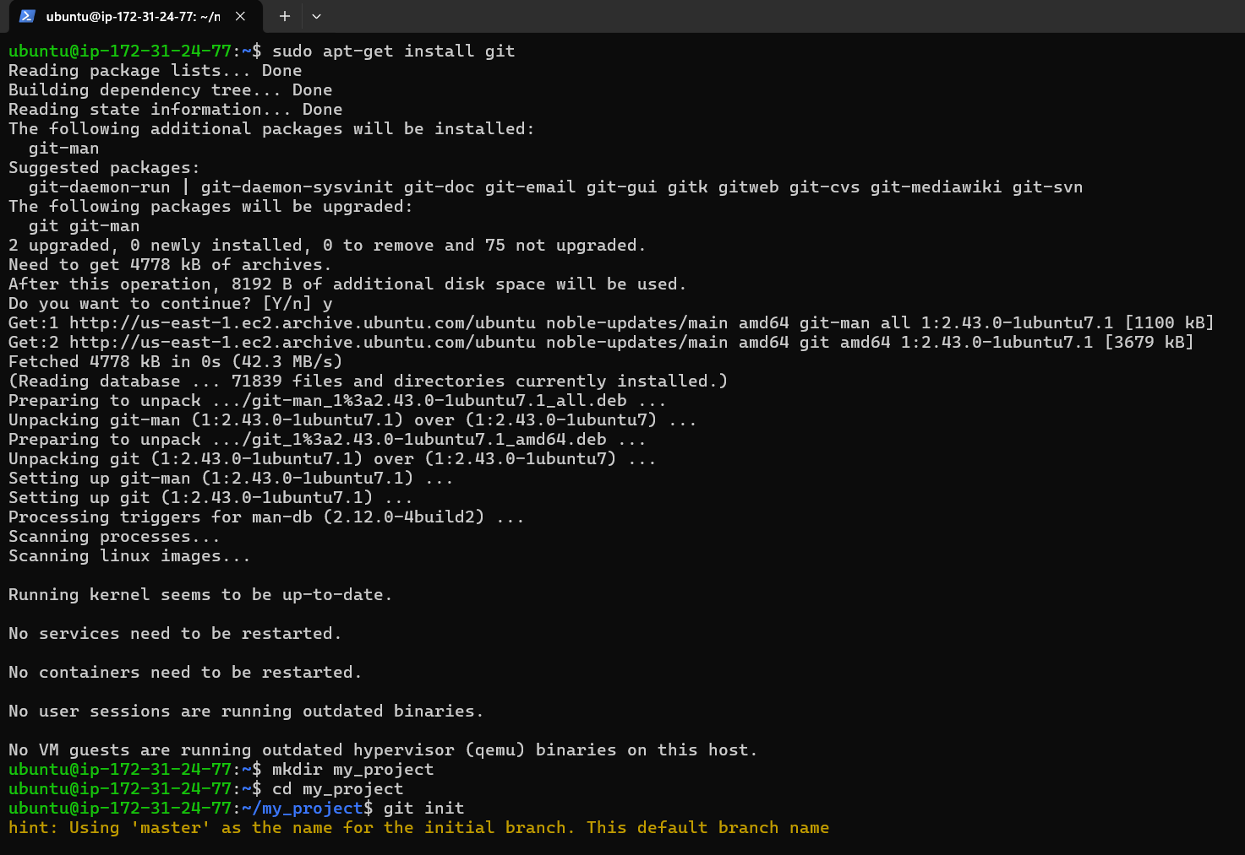
1. Set up a Remote Repository in Local, Add a file, commit or save and push to the master Branch:-

Slide 3
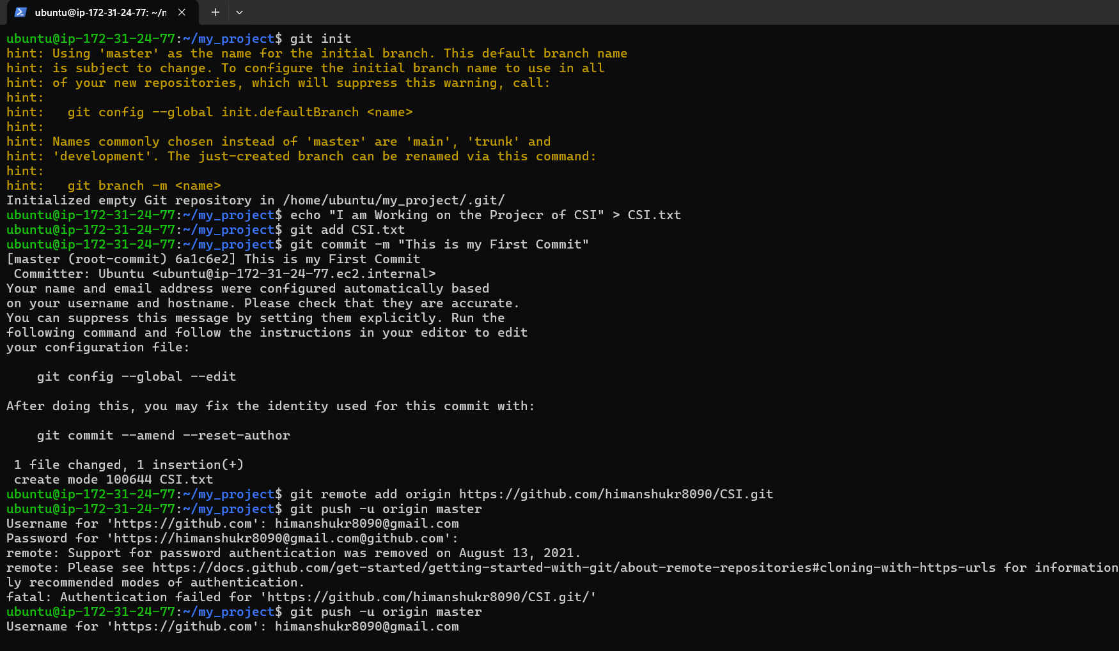

Slide 4
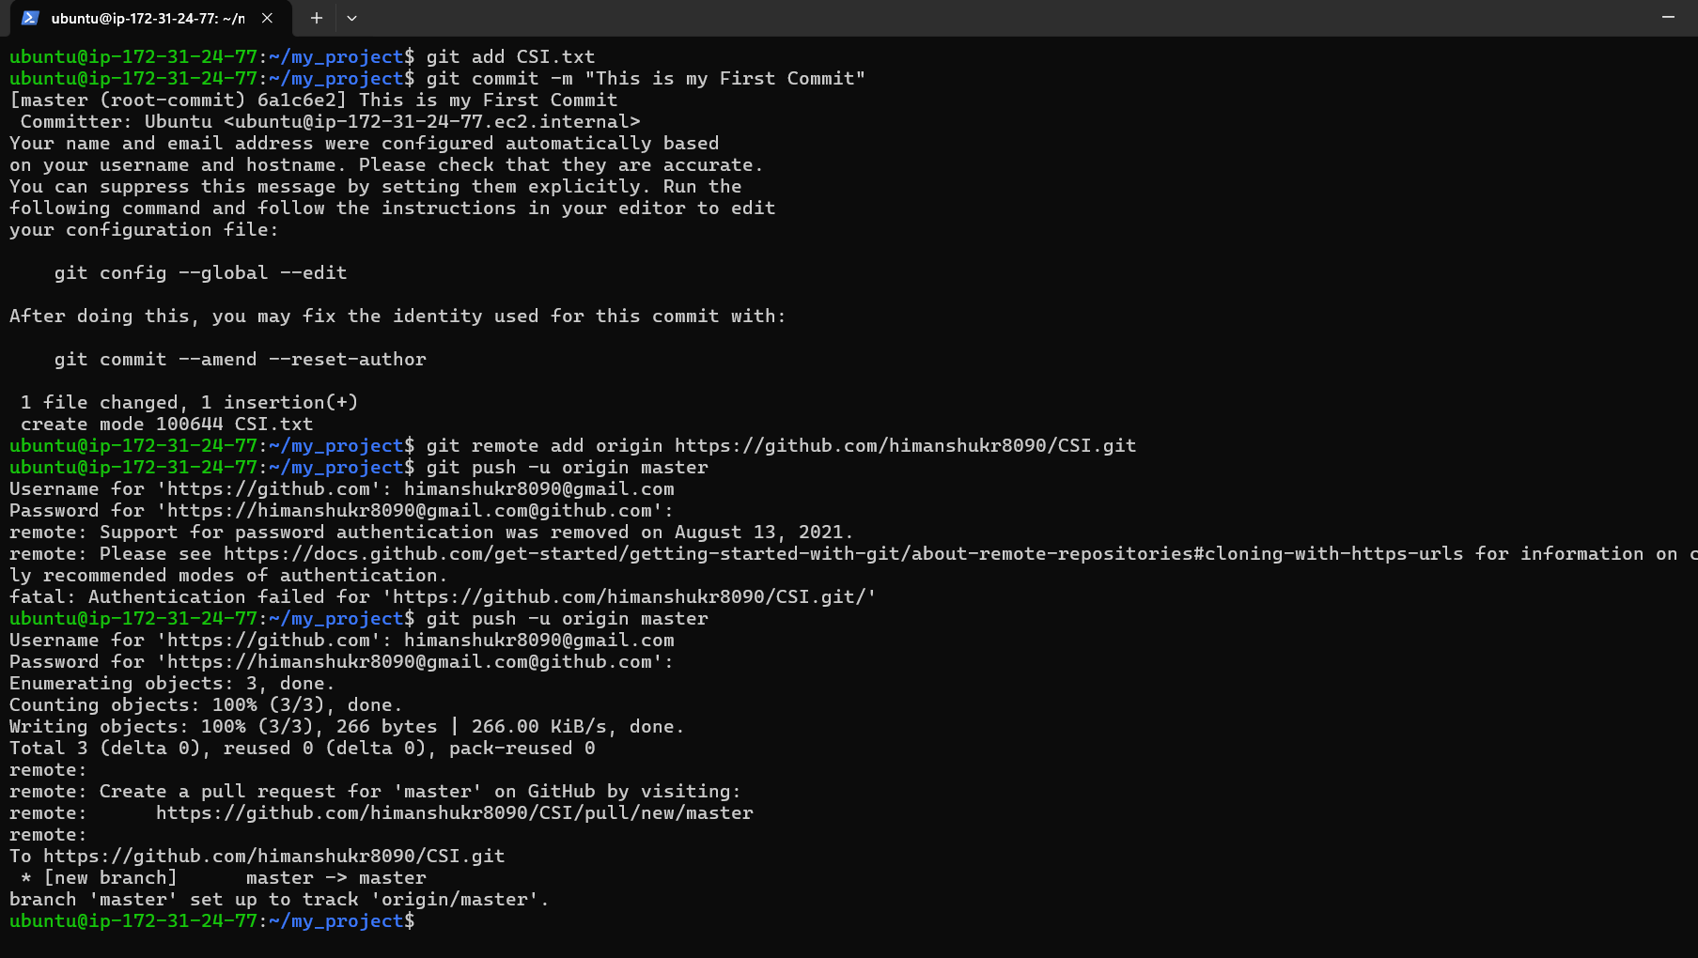

Slide 5
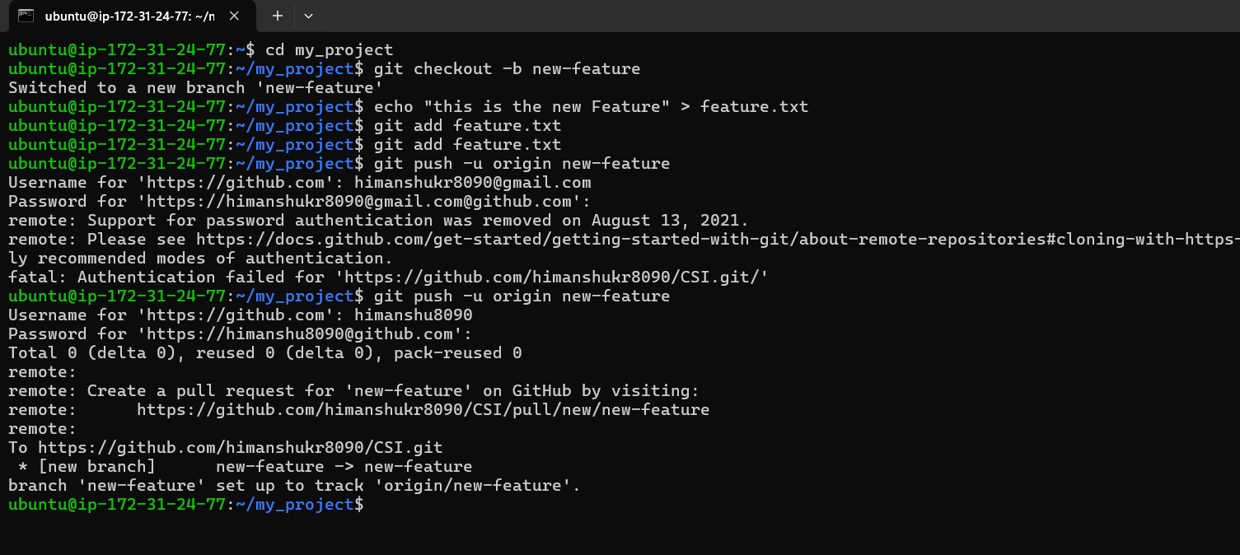
2. Create a New Branch then Commit and push the Change to new branch and merge it with the master Branch using pull request

Slide 6
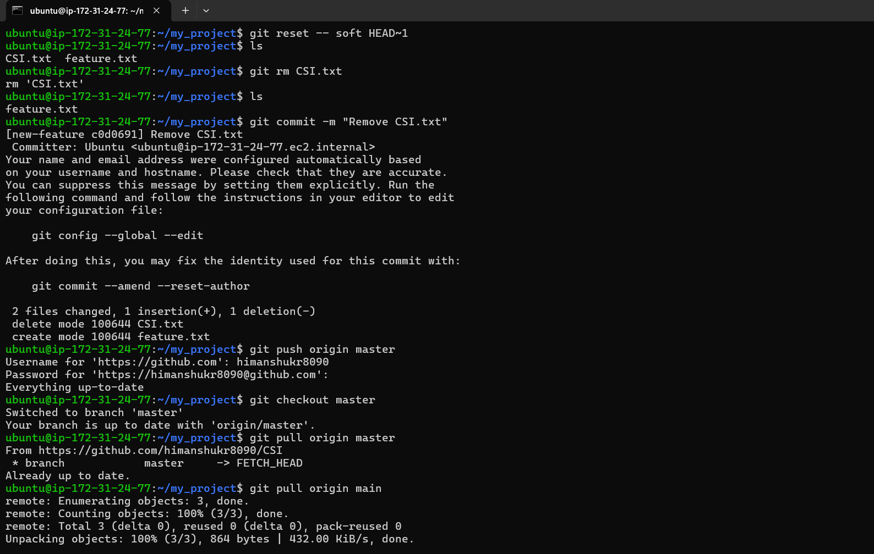
3. Undo the last commit or remove the last created file:-

Slide 7
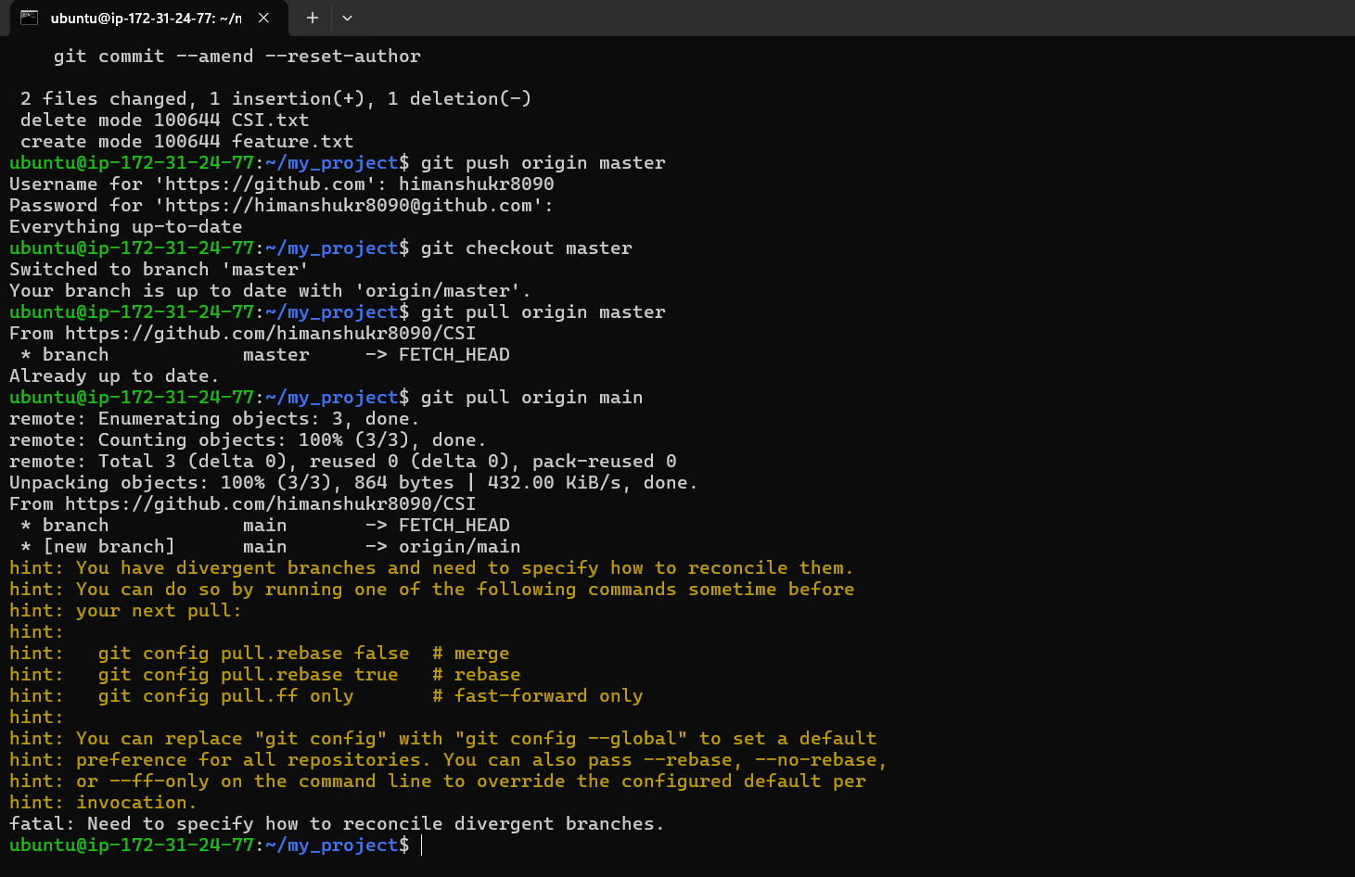

Slide 8
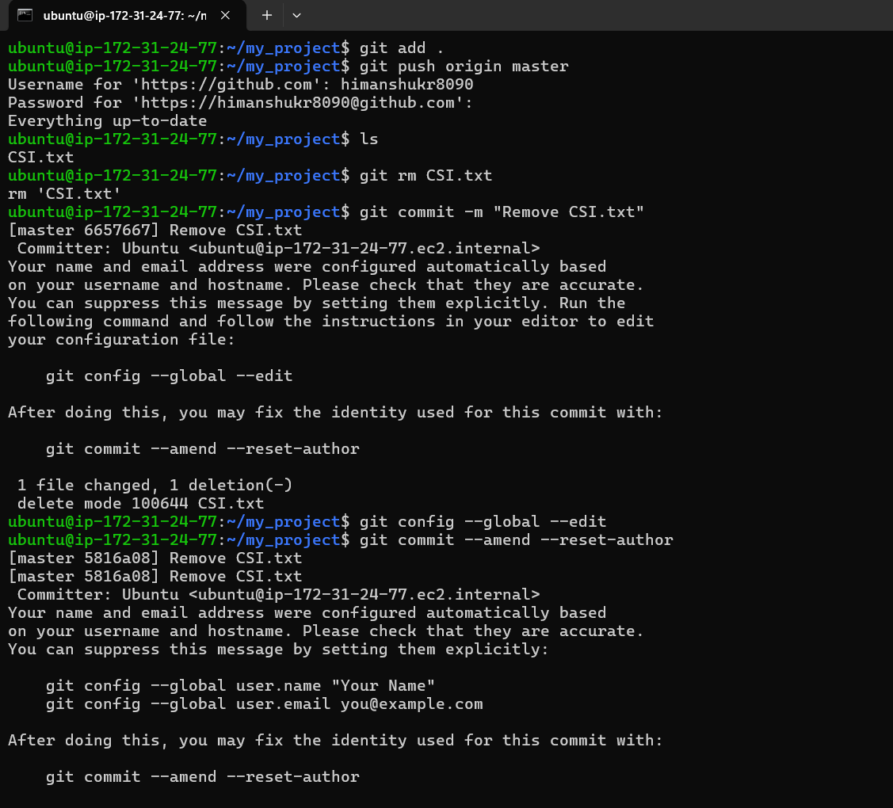
4. Resolve the merge conflict:-

Slide 9
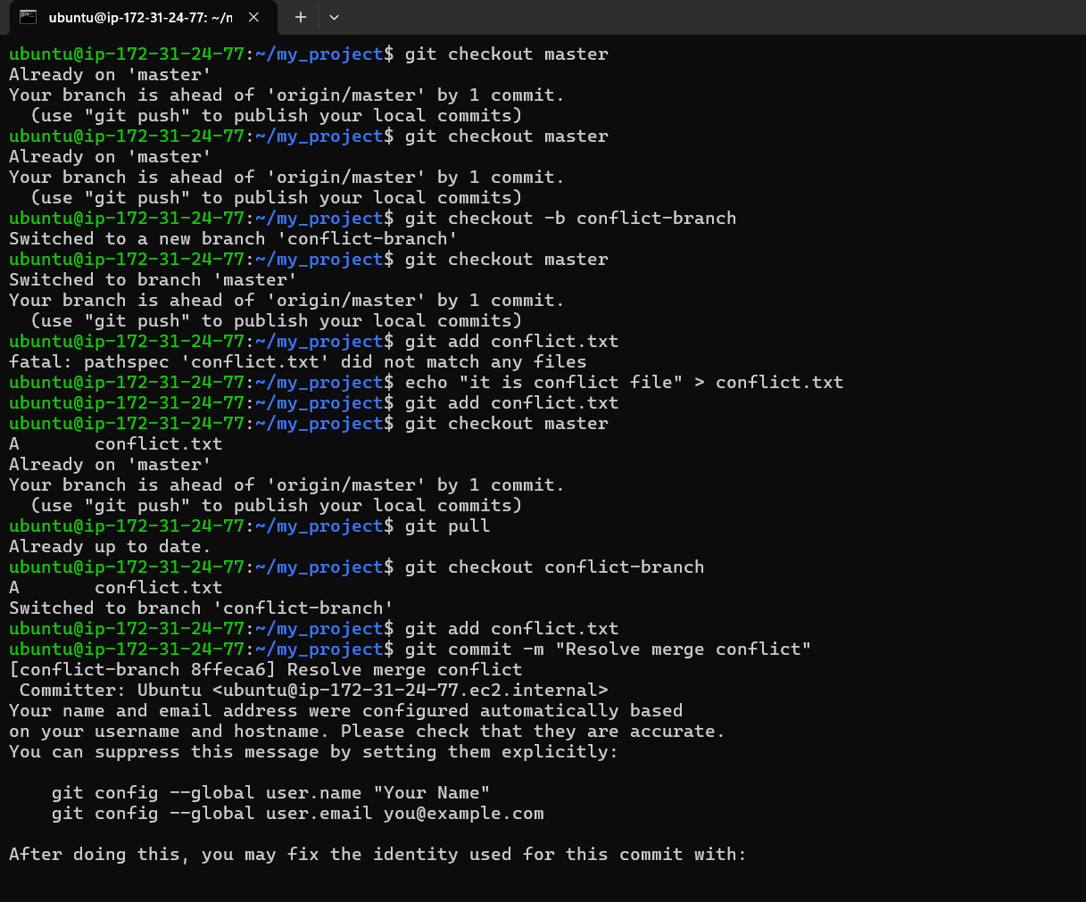

Slide 10
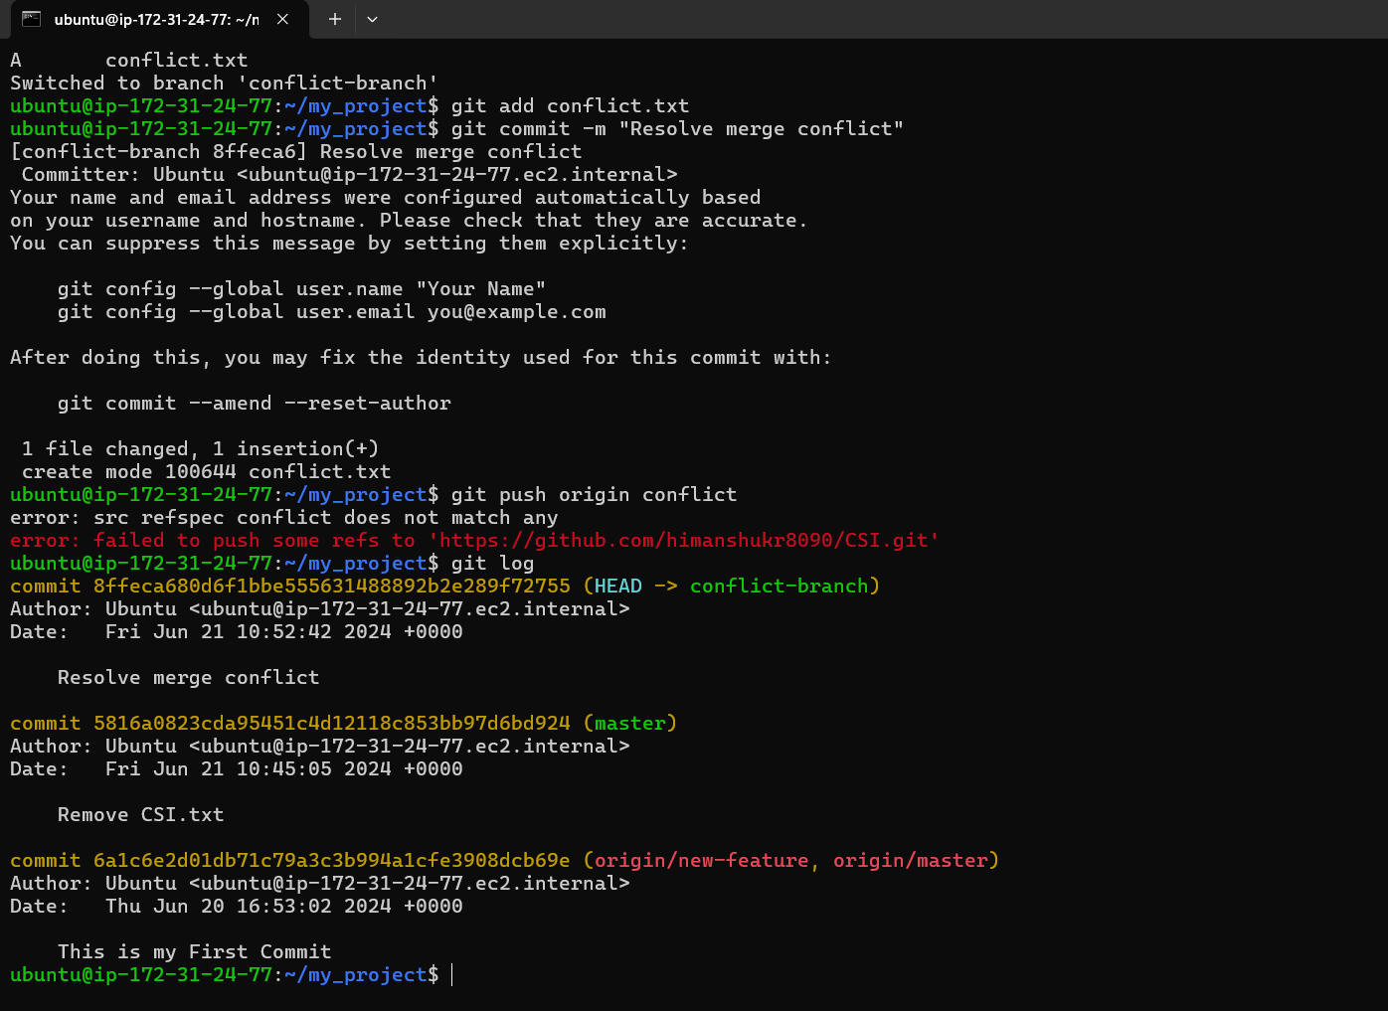

Slide 11
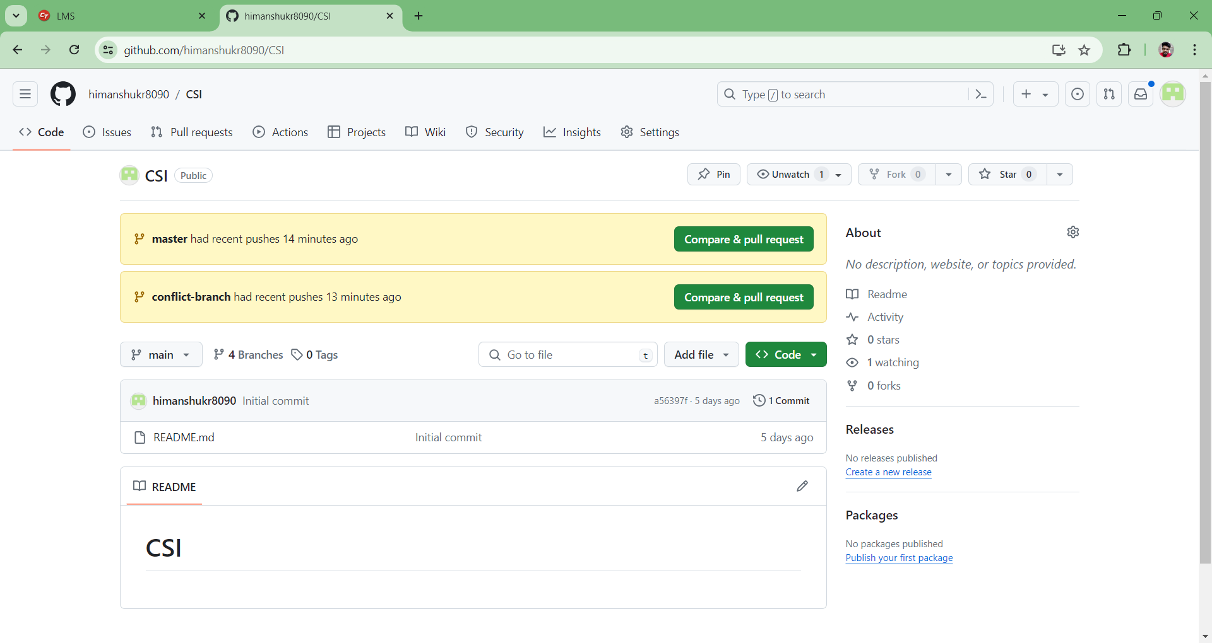

Slide 12
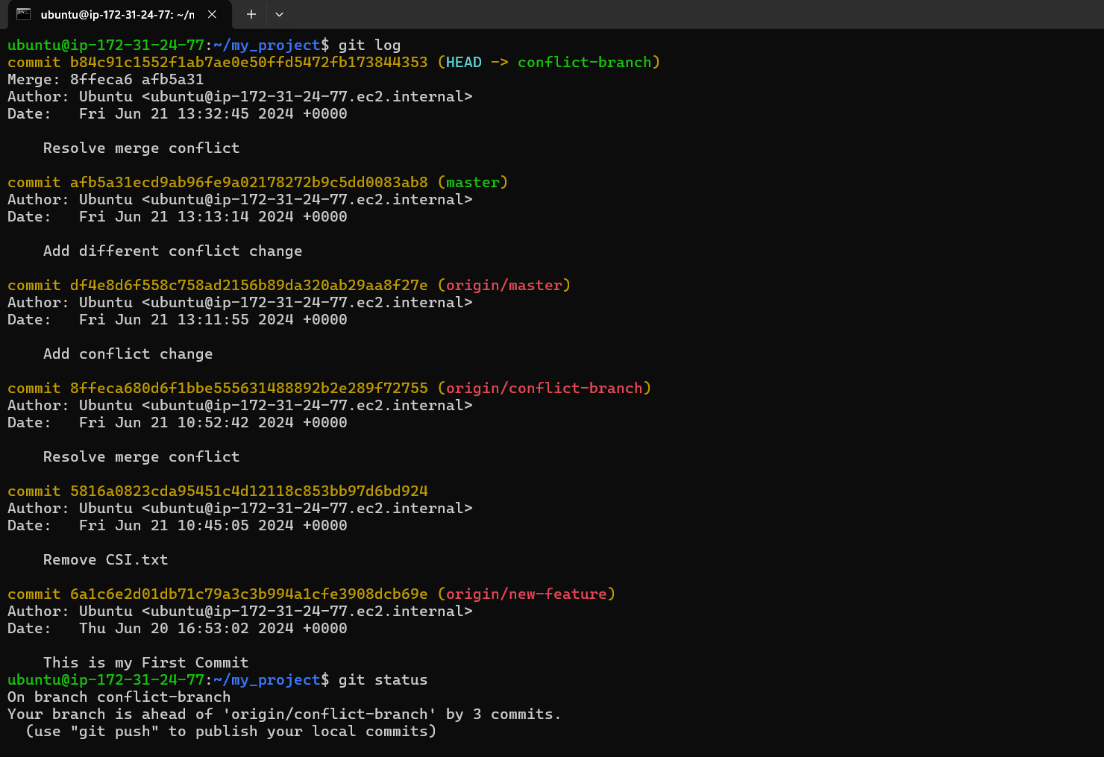
5. Practice more Git Commands-

Slide 13
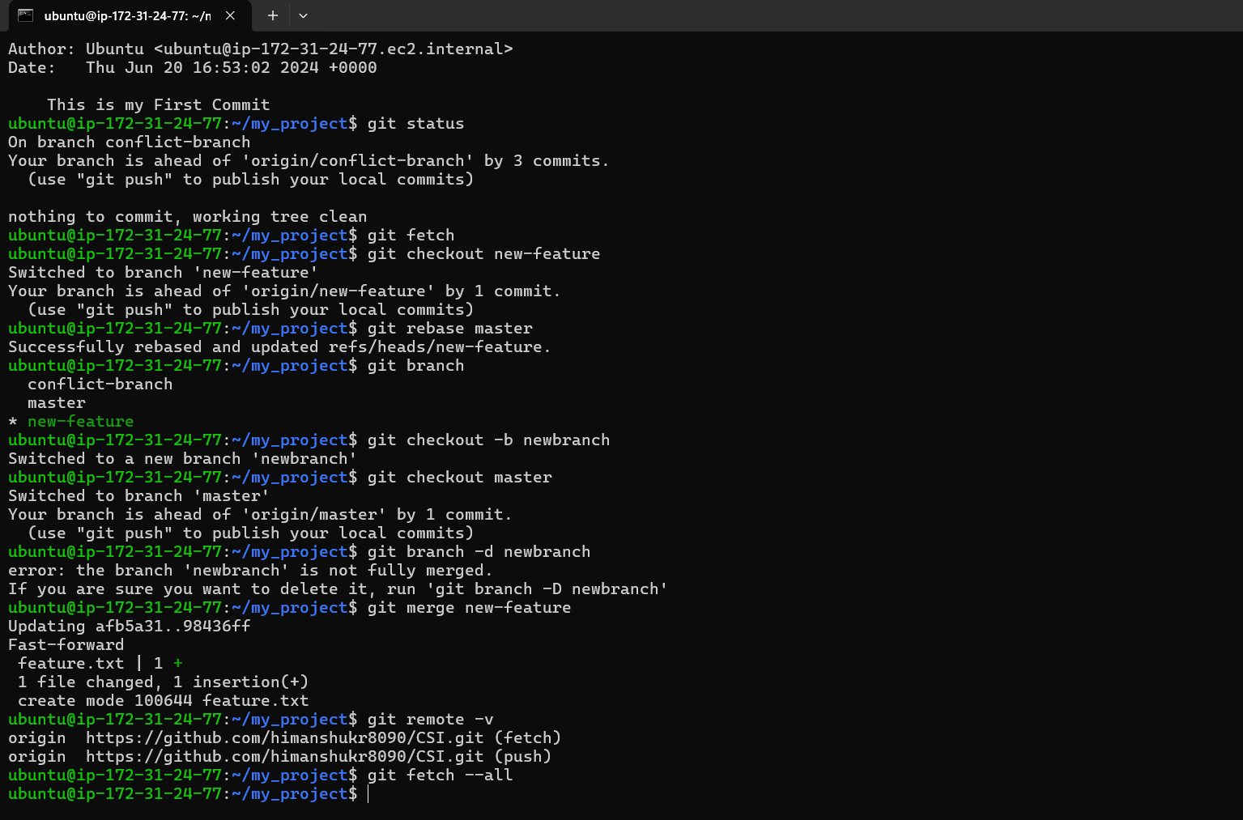

Slide 14
Thanks

